Slide 1
COMMONWEALTH OF AUSTRALIA
Copyright Regulations 1969
WARNING
This material has been copied and communicated to you by or on behalf of The University of Newcastle pursuant to Part VB of the Copyright Act 1968 (the Act).
The material in this communication may be subject to copyright under the Act. Any further copying or communication of this material by you may be the subject of copyright protection under the Act.
Do not remove this notice.

Slide 2
SENG2260 Human-Computer Interaction
Week 11a: Human Factors and Security

Slide 3
Aims
To consider the human element in computer system
Explore human error issues for HCI
Define human issues in evaluation
To consider human engagement in security issues
To define security design guidelines

Slide 4
Overview
Humans are important as part of system dependability and successful use
Human operator errors are the largest single source of failures in many systems
Human interaction with system is via the user interface
Human errors are inevitable despite the best training and UI development
How can we build systems that tolerate human error?

Slide 5
The human element
Systems
Hardware, software, liveware (or peopleware)
One approach to systems is to make them simple
Reduced complexity aids understanding
Not possible with the addition of humans as highly complex entities
Humans as components are:
Often unreliable
Unpredictable (not deterministic)
Vary enormously
Sex, age, physical and cognitive aspects, cultural
Issues with systems can sometimes be directly attributed to human error
Developer vs. the user distinction?

Slide 6
Allocation of functions
What are computers good at?
Speed (fast but stupid?)
Following predefined sets of instructions
What are people good at?
Judgement calls (slow but clever?)
Flexible and adaptable (especially with the unknown)
Can we remove humans from the tasks that can be implemented by following a well-defined set of rules
But do we trust the automation?
Consider automation in user interfaces? Helpful or not??

Slide 7
System complexity
Having humans in the system loop adds complexity but also shifts responsibility
Implications for integrity requirements on systems
Example of a train driver. Controls the speed of the train and is required to respond to signal and to environmental conditions
Supported by some automated features
“Dead man’s handle” for automatic braking
If we remove the driver, we then depend heavily on computer-based solutions to maintain train separation and ensure passenger safety
Consequence of failure is high
Wider implications for the connecting systems – cost
Many systems are build on human strengths
Would like to build interfaces that build on these strengths, but …
This then can be a weakness in the use of the system

Slide 8
HUMANS IN THE SYSTEM
Producer
Operator/user
Design
team
Customer
System
Public
Maintainer
Installer

Slide 9
Human involvement
Human operators, as part of the system
Humans who design, build and install systems
Humans who maintain systems
Humans certify the systems
Which uses a large amount of subjective judgement calls

Slide 10
Human errors are inevitable
Human error
Slips - formulate the right action but fail to execute that action correctly
Mistakes – do not formulate the right action
Errors occur despite experience
Training and familiarity can’t eliminate errors
60% of errors are on “skill-based” automatic tasks
30% of errors on “rule-based” reasoning tasks
10% of errors on “knowledge-based” tasks that require novel reasoning
Question: How do we build interfaces to reduce human error?

Slide 11
Types of human error
Human error can occur at different levels
Skill-based: usually errors of inattention or misplaced attention …
Rule-based: picked inappropriate rule, misdiagnosed state of system, deficient rules …
Knowledge-based: incomplete/inaccurate understanding of system, overconfidence, cognitive strain …
System design affects error-susceptibility
Bad design, poor usability -> HCI issues

Slide 12
Dangers of automation
Automation often addresses skill and rule-based tasks
Complex knowledge-based tasks left for the human operator
However, under stress, humans are ill-suited to knowledge-based tasks
Implications of automation
Can hinder understanding and mental modelling
Decreases system visibility and increases complexity
Operator’s don’t get hands-on control experience

Slide 13
Human involvement is unavoidable
Any involvement provides opportunity for errors
Build systems that can cope with human error
Fault tolerance systems
Focus on recovery?
Question: What might be an example of fault tolerance for a user interface?
undo: the ultimate recovery mechanism?
Ubiquitous and well-proven in productivity applications
Familiar model for error recovery
Enables trial-and-error interaction patterns
undo for system maintenance
“Time-travel” for system state
Must encompass all hard state, including hardware and network configuration
Must be flexible, low-overhead, and transparent to end user of system

Slide 14
Humans in evaluation
Part of the process of verifying and evaluating a system
Verification – the process of determining whether the output of a lifecycle phase fulfils the requirements specified by the previous phase
Validation – the process of confirming that the specification of a phase, or of the complete system, is appropriate and is consistent with the customer requirements
Testing – the process used to verify or validate a system or its component.

Slide 15
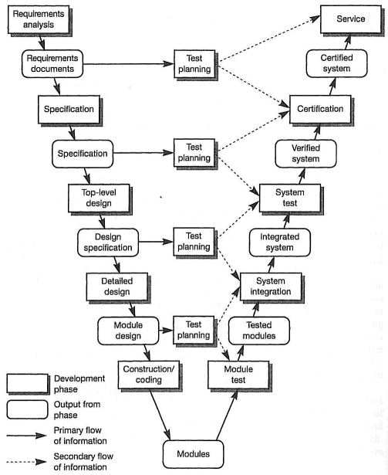
V development model with test planning

Slide 16
Humans in the system: summary
Humans are critical to system development and use
Human error is inescapable
Blame the user instead of fixing systems
Need to take human error into account when building and evaluating systems
In system design, by providing tolerance
Or in recovery mechanisms like undo

Slide 17
Security as a non-functional requirement
Dependability
Reliability
Availability
Safety
Security

Slide 18
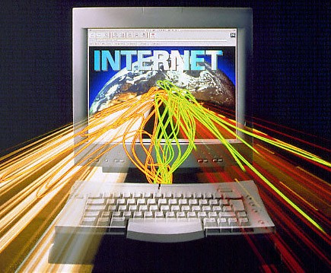
Security considerations
Security is a system attribute that reflects the ability of the system to protect itself from external attacks
Attacks may be accidental or deliberate
Influence of the Internet
Increased opportunities for attack
Increased information distribution
On system vulnerabilities
On patches and upgrades
Example attacks
Viruses, unauthorised use of system services and unauthorised modification of the system or its data
Poor interface design can increase a system’s vulnerability to other attacks

Slide 19
Security aspects
Security can be considered over three main aspects
Confidentiality
Prevention of the unauthorised disclosure of information
Integrity
Prevention of the unauthorised modification of information
Availability
Prevention of the unauthorised withholding of information of resources
Question: Consider how UI components can help/hinder the security of the underlying system?

Slide 20
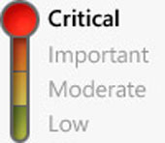
Security for critical systems
For some critical systems, security is the most important of the dependability attributes
Military systems
Electronic commerce
Systems involved in the processing and interchange of confidential information
Requirement for a high level of security
Reliability and availability may cause inconvenience but security can compromise the whole system environment

Slide 21
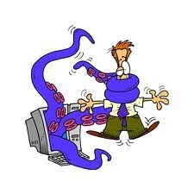
Points of attack
A system consists of hosts (servers and clients), networks, applications, system administration, users and attackers
Points of attack at host and communication links
The people – e.g. social engineering
The server – e.g. malicious input for buffer overflows
The software – e.g. “upgrades” and viruses
The data – e.g. configuration data
The network – e.g. “spoofing” to access traffic

Slide 22
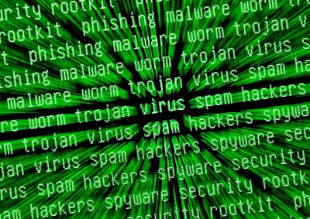
Categories of attack
Interception
Attack on confidentiality
Modification
Attack on integrity
Interruption
Attack on availability
Fabrication
Attack on authenticity

Slide 23
Damage from external attacks
Denial of service
System forced into a state where its normal service becomes unavailable
Impacts availability
Corruption of programs or data
Software components altered in some unauthorised way
May affect the systems behaviour and impact reliability and safety
Disclosure of confidential information
Exposure to unauthorised people
Depending on the nature of the information, this could affect the safety of the system
May allow later attacks that affect system availability or reliability

Slide 24
Security terminology
Exposure
Possible loss or harm in a system. Loss or damage to data or loss of time and effort if recovery is necessary after a security breach
Vulnerability
A weakness in a computer-based system that may be exploited to cause loss or harm
Attack
An exploitation of a system’s vulnerability. Usually from outside the system and is a deliberate attempt to cause some damage

Slide 25
Security terminology2
Threats
Circumstances that have potential to cause loss or harm. A system vulnerability that is subjected to an attack
Control
Protective measure that reduces a system’s vulnerability. Encryption would be an example of a control that reduced a vulnerability of a weak access control system
Question: What threats do visual passwords or fingerprint identification in a UI login control?

Slide 26

Security design
Security analysis of a design focuses on identifying the following:
Data flow between components
Users, roles and rights
explicit or implicit
Trust relationships of each component
Potentially applicable solutions to recognised problems

Slide 27
Security design guidelines
Secure the weakest link
Security is only as strong as its weakest link
Attackers will look for and exploit weak points before data is encrypted and after data is decrypted as attacking encrypted data is too difficult
The weakest link is usually the users and system administrators who are subject to social engineering attacks
Practise defence in depth
Managing risk with diverse defensive strategies
If one layer is inadequate, another layer with prevent the breach
For example multiple firewalls combined with data encryption

Slide 28
Security design guidelines 2
Fail securely
Failure is often unavoidable. Avoid systems moving to insecure states when they fail
Follow the principle of least privilege
Only the minimum privilege necessary to perform an operation should be granted and then only for the minimum amount of time necessary
Compartmentalise
Isolate code module by security privileges to minimise potential exposure and damage
Keep it simple
Limit functionality as limited functionality is easier to protect

Slide 29
Security design guidelines 3
Promote privacy
Educate users and system admin. Restrict public information on system operation (e.g. login/password pairs)
Be reluctant to trust
Servers should be designed not to trust clients and clients should be designed not to trust servers
Trust is transitive. Trusted programs should not invoke un-trusted programs
Use of community resources
Place more trust on publicly available algorithms and security libraries that have been subjected to repeated use without failure
Particularly true for open source material that has had public scrutiny

Slide 30
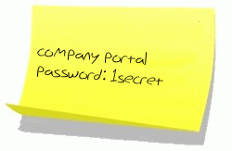
The human factor
Majority of vulnerabilities in computer- based systems result from human failings rather than technical problems
People choose easy to guess passwords
People write their passwords down
System administrators make errors in setting up access control or configuration files
User forget to install, use and update protection software
Improving security requires us to consider the socio-technical perspective
How systems are actually used
Not just the technical characteristics

Slide 31
SENG2260 Human-Computer Interaction
Week 11b: Social and Ethical Concerns

Slide 32
Learning Objectives
To define and discuss the nature of the social context of HCI development
Understand and discuss the social aspects of information systems and how HCI can improve these aspects
Understand and discuss the ethical aspects of information systems and how HCI can improve these aspects
Consider the ethics of user testing

Slide 33
Social Context
Social Issues | Concern | Implications for Design
Anxiety | Fear of computers | Design for ease of use and ease of learning Standardization is critical
Alienation | Feelings of separation and disenfranchisement | Design to enrich computer-mediated interactions (i.e., add emotional indicators)
Potency and Impotency of the Individual | Feelings of powerlessness | Design to support empowerment (i.e., internal locus of control)
Complexity and Speed | Feelings of bewilderment and confusion | Design to reduce complexity and give user control over rates of speed
Organizational and Societal Dependence | Feelings of helplessness and inability to perform | Design for reliability and human backup
Unemployment and displacement | Fear of financial incapacity | Design for job enrichment Design retraining systems
Valuing Human Diversity | Feelings of belongingness and fit | Understand diverse user populations and design to fit
Summary of Social Issues and their Impacts on HCI

Slide 34
Anxiety
What can designers do to alleviate the anxiety that inexperienced users may feel about the use of computers?
The key lies in ease of use.
Natural user interfaces
Forgiving systems
User control

Slide 35
Alienation
Computers can contribute to feelings of alienation in society.
Consider, for example, the changing nature of white-collar work in large organizations.
Face-to-face communications have been replaced by computer-based communications
Although work is collaborative, it is often remote
Human intervention is lessened

Slide 36
Alienation
What can designers and implementers of computer-based systems and social-technical engineers do to combat this potential alienation that is an unintended outcome of computer use?
Designers must therefore be socially active
Communication support systems can indicate emotions
Emoticons
Multi-media systems may include video and voice

Slide 37

Alienation
:) classic smile
:-* kiss
:-@ screaming
:-< very sad
:-c very unhappy
:-] tongue in cheek
]:-> devil
|-o Yawn
‘:-) raised eyebrow
Assorted Instant Messenger Smiley Faces
Emoticons:
Combinations of Special Characters
that can be Added to Text
Communications to Convey Emotion.

Slide 38
Potency and Impotency of the Individual
The prevalence of computer-based systems as interfaces between people and organizations can add to our feelings of impotence.
When a seemingly simple task, such as correcting a mistake in a bill, puts us in contact with a computer rather than another human we may feel powerless and frustrated.
Can we build interfaces to empower low-skilled workers or provide training and education for every member of society?

Slide 39
Complexity and Speed
Computers allow us to accomplish more tasks in less time.
The interjection of computers into our daily lives increases the complexity and speed of our experiences.
Designers should try to simplify and slow down some tasks
By focussing on human concerns?

Slide 40
Organizational and Societal Dependence
Societal dependence on computer-based systems means that if these systems break down, the society or organization breaks down.
This possibility contributes again to a feeling of helplessness and reliance on machines.
Networks can cause a concentration of expertise/infrastructure
easier to bring down a system.
Developers need to produce robust, fault tolerant designs

Slide 41
Unemployment and Displacement
Re-engineering and automation of work processes often leads to job displacement.
Up skill the population?
Fixing this problem cannot be the direct responsibility of systems designers since their job is to build efficient and effective systems.
It is the responsibility of an organization to anticipate these changes and offer retraining and other jobs within the organization.

Slide 42
Valuing Human Diversity
What can computer-based systems do to increase the perception that humans, of diverse backgrounds and skills, are valued?
The most obvious suggestion is to design interfaces that take human diversity into consideration.
Interfaces should be flexible and adaptable
Designers should make clear design choices that reflect a neutral, non-biased interaction.

Slide 43
Ethical Considerations
Accessibility
As computers become more and more prevalent in our society, the consequences of the gap between those who have access to computers and those who do not become greater and greater.
Access:
Providing access to information via information systems and technologies is critical to full societal participation.
HCI can play a role in breaking through barriers to access.

Slide 44
Ethical Concerns - Privacy
Privacy: Protecting against public access to personal information about individuals.
Computers provide information about individuals in ways we only begin to understand.
Credit bureaus in the US such as Equifax have computerized data about almost all Americans
Future implications?
What is your digital footprint?

Slide 45
Cyberbullying
Threaten, harass, humiliate or embarrass another person (especially vulnerable) using internet, digital media or mobile phones.
Many children have been involved, often from both sides.
Is this a social problem exacerbated by technology?
Does a user-friendly interface make cyberbullying easier?
What can be done?
May be by direct message or by proxy.

Slide 46
Ethical concerns – Accountability
Accountability and Accuracy: Understanding who shares responsibility for the outcomes and impact of information systems.

Slide 47
Online predators
Development of simple interfaces open social network sites to children making them vulnerable to cyberstalking or grooming.
Child protection locks – made simple so parents will use them but not simple that children can circumvent them.
Making it easy to “out” online predators could be open to abuse.
Trolls?
Similar to SWATing?

Slide 48
Ethical considerations – Intellectual Property
Intellectual Property: An intellectual property is any product of the human intellect that is unique, novel, and has some value in the marketplace.
Electronic form of intellectual property is difficult to safeguard.
Manchester church example

Slide 49
Ethics of user testing
Users are human beings
All research institutions have a Human Research Ethics Committee (HREC)
https://www.newcastle.edu.au/research-and-innovation/resources/human-ethics/about-us

Slide 50
Pressure on the User
Performance anxiety
Feels like an intelligence test
Comparing self with other subjects
Feeling stupid in front of observers
Competing with other subjects

Slide 51
DECIDE about ethical issues
Develop an informed consent form
Participants have a right to: - Know the goals of the study; - Know what will happen to the findings; - Privacy of personal information; - Leave when they wish; - Be treated politely.
Notes:
51

Slide 52
UON ethics approval process
Design study/experiment
Generate documentation
Complete RIMS online form
Peer review (Faculty level)
Wait (2-3 weeks)
Revise
HoS sign off
Submit to HREC (University level)
Wait (6-8 weeks)
[Revise and resubmit]
[Hopefully] Get ethics approval
Enact study plan

Slide 53
This session
You will have:
Considered social concerns for human computer interaction design and how this might impact interface designers
Considered ethical implications in interface design and specifically with user testing
Explored the documentation from a real ethics case study

